Slide 1




Integrated RNA-DNA
Allelic Maps of Cancer
Anelia Horvath, PhD
Co-Director, McCormick Genomic and Proteomic Center
Department of Pharmacology & Physiology
Department of Biochemistry & Molecular Medicine
The George Washington University

Slide 2
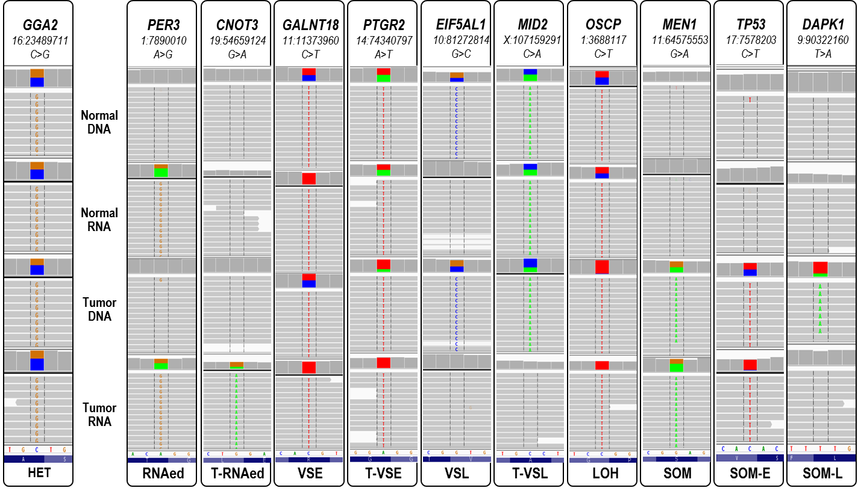
Asymmetric RNA-DNA allele frequencies typically:
Indicate disturbances in the genetic flow
Show characteristic patterns associated with the underlying biological processes
Aligning normal and tumor RNA and DNA allows
the identification of variety of regulatory and structural features

Slide 3

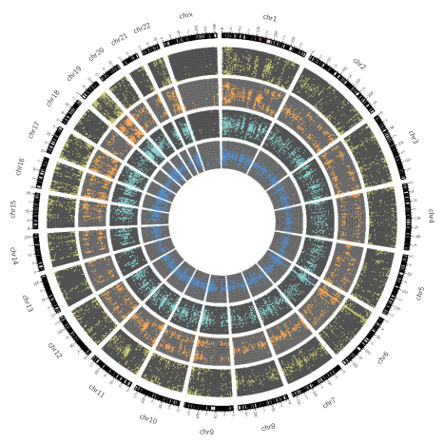
RNA2DNAlign (https://github.com/HorvathLab/NGS)
Allelic Events
Allelic Maps
Movassagh et al., Nucleic Acids Research, 2016

Slide 4
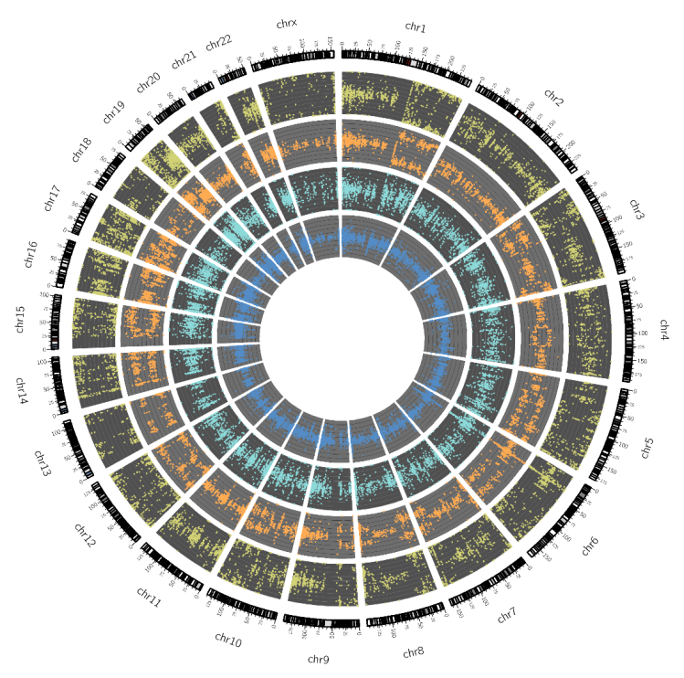
Allelic Maps
From Individual variants to molecular entirety
Can we infer allelic copy number changes and genome admixture from the allelic maps?
Notes:
This pattern is, although imperfectly, followed by the tRNA. Being imperfect, however, this pattern correlation apperaed to be far from random, and showed some strong rules, which, after analuzing hundreds of samples, we confined to the following several most important observations.
Bimodal VAF{tDNA} in loci with heterozygote signals in the nDNA (which are technically all the regions since we plotted only the heterozygote positions in the NDNA) with corresponds to aneuploidy
Of note, the above assumptions represent the lowest complexity models with a minimal number of contributing events.

Slide 5
From center outwards:
normal DNA normal RNA
tumor DNA
tumor RNA
Build Allelic Maps:
1) Compute VAF (Variant Allele Fraction): VAF = N_{var} / (N_{ref} + N_{var})
2) Select a primary dataset – normal DNA
3) Select primary context: heterozygote positions in normal DNA
Common notion on VAF distribution:
VAF{DNA} ~ 0.5 corresponds to a true allelic ratio of 1:1 for heterozygote sites in a pure diploid single-genome sample (normal DNA, inner layer)
Bimodal VAF{tDNA} in loci with heterozygote signals in the nDNA (VAF{nDNA} ~ 0.5) - allelic copy number changes (0/1 deletion, 0.33/0.67 – allele-specific duplication, 025/0.75 triplication, etc, tumor DNA, 3rd layer).
Bimodal VAF{RNA} approximating 0/1 - monoallelic expression (tumor RNA, outer layer)
VAF
N_{var}
N_{ref} + N_{var}

Slide 6
Integrated VAF{RNA}-VAF{DNA} behaviour:
VAF{tRNA}-VAF{tDNA} bimodal regions present with concordant and discordant patterns
Samples present with either (1) concordant VAF{tRNA}-VAF{tDNA} only, or, (2) concordant and discordant VAF{tRNA}-VAF{tDNA} patterns.
Within a sample, the discordant patterns are constant
In discordant regions VAF{tRNA} is always 0/1.
concordant:
VAF{tDNA} = VAF{tRNA} = 0.33/0.67
discordant
VAF{tDNA} = 0.33/0.67 <> VAF{tRNA} = 0/1
HYPOTHESIS:
Discordance in VAF{tRNA}-VAF{tDNA} patterns is linked to genome admixture; RNA and DNA allele frequencies can mutually inform each other to simultaneously infer ploidy & genome admixture
A commonly probed tumor sample represents a mixture of tumor clonal subpopulations with different copy gains and losses with normal tissue and infiltrating normal cells from the microenvironment.

Slide 7
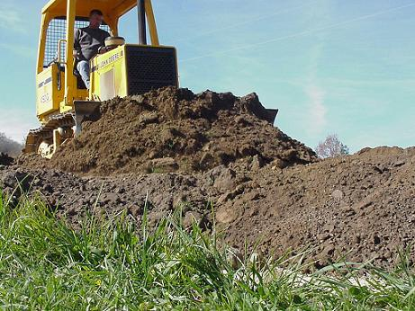
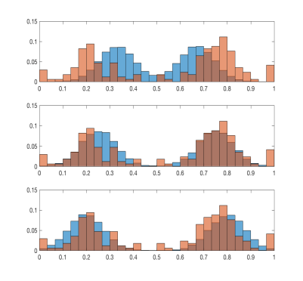
HYPOTHESIS: Discordance in VAF {tRNA} – VAF {tDNA} patterns is linked to genome admixture; RNA and DNA allele frequencies can mutually inform each other to infer ploidy & genome admixture
CHALLENGE: (1) high heterogeneity of the signal from sequencing (short reads, technical variability);
(2) different molecular nature of RNA and DNA (limited compatibility)
PROPOSAL: Use Earth’s Mover’s Distance (EMD) to quantify the distributions of VAF{DNA} &VAF{RNA}
EMD:
Solution to optimal transportation problem; popular tool in image analysis and pattern recognition
Minimal cost to transform one distribution to the other. One distribution can be seen as a mass of earth spread in space, the other as a collection of holes in that same space
Distributions are represented as a set of clusters and an associated weight. Computing the dissimilarity then becomes the transportation problem
Non-parametric, computationally efficient, tolerant to imperfect matches, sensitive to high-variability data.

Slide 8
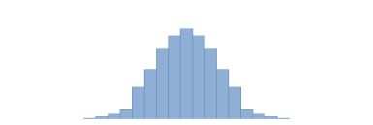
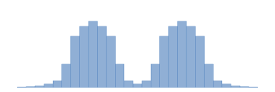
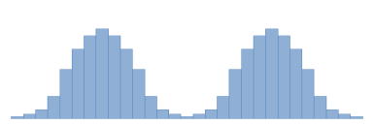
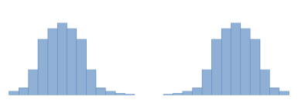
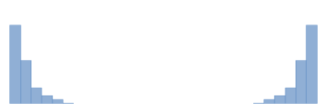
Apply EMD to quantitatively assess and compare the distributions of VAF{DNA} &VAF {RNA} with the goal to infer ploidy (copy number alterations) and genome admixture
CHALLENGE: At any given genomic interval the proportions of ref:var alleles (VAF) can be obtained from different combinations of cellular populations (r_N) and allele-specific gains and losses. Data has high variance; hence no exact value of modes can be estimated from VAFs.
The task constitutes an inverse problem with a non-unique solution.
PROPOSITION:
1) Generate a Model Dictionary that contains all possible values of modes estimated from VAF (with given resolution) for different combinations of r_N and allele-specific amplifications and losses (within selected complexity limits of r_N and ASCNA*).
2) Partition the genome into a sequence of non-overlapping intervals with constant VAF{DNA} modes using adaptive windows (KS-test).
3) Apply EMD to determine VAF{tDNA} and VAF{tRNA} modes for each segment with constant modes:
EMD (PDF₁(z), PDF₂(z)) = ∫_{z} |CDF₁(z) – CDF₂(z)|d(z)
where the modes are determined based on minimal EMD between idealized (Model Dictionary) and observed distributions.
4) Apply EMD to measure the space between VAF{tRNA} and VAF{tDNA} relative to the (0/1) scale.
MODEL DICTIONARY
Possible idealized VAF distributions
(*5.10e8 for r_N=5 and ASCNA=5)
0.5
unimodal
0.33 0.67
0.25 0.75
bimodal
0.2 0.8
0 1

Slide 9
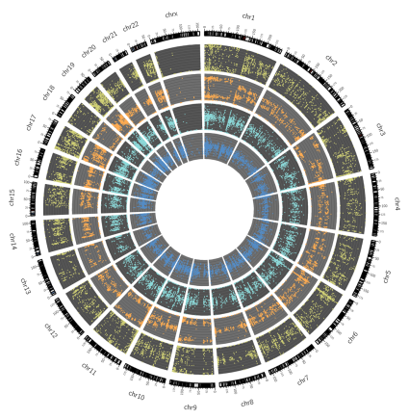
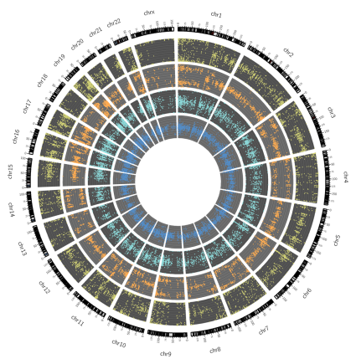
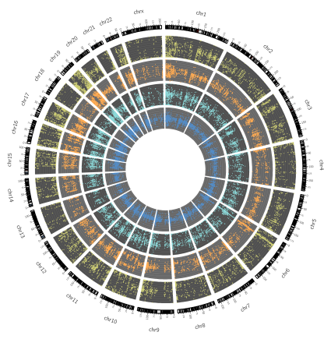
Apply EMD to quantitatively assess and compare the distributions of VAF{DNA} &VAF {RNA} with the goal to infer ploidy (copy number alterations) and genome admixture
PRAD
BRCA
LUAD
Build Model Dictionary of possible Idealized VAF distributions
0.33/0.67
0.25/0.75
0.2/0.8
0/1

Slide 10
Apply EMD to quantitatively assess and compare the distributions of VAF{DNA} &VAF {RNA} with the goal to infer ploidy (copy number alterations) and genome admixture
PRAD
BRCA
LUAD
chr1p
chr7p
chr4
0.33/0.67
0.25/0.75
0.2/0.8
0/1

Slide 11

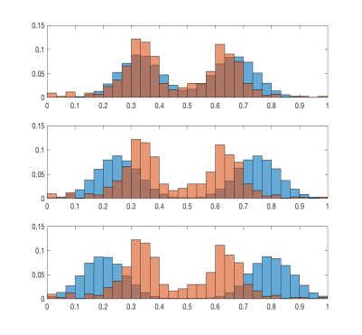
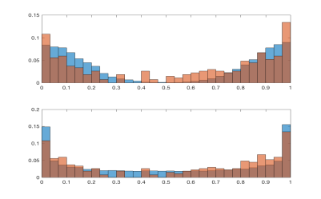
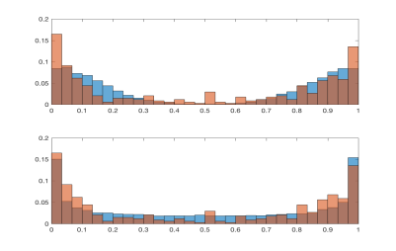
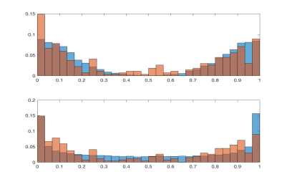
Apply EMD to quantitatively assess and compare the distributions of VAF{DNA} &VAF {RNA} with the goal to infer ploidy (copy number alterations) and genome admixture
PRAD
BRCA
LUAD
chr1p
chr7p
chr4
0.33/0.67
0.25/0.75
Idealized bimodal VAF distributions
0.2/0.8
0/1

Slide 12
Apply EMD to quantitatively assess and compare the distributions of VAF{DNA} &VAF {RNA} with the goal to infer ploidy (copy number alterations) and genome admixture
PRAD
BRCA
LUAD
chr1p
chr7p
chr4
0.33/0.67
VAF{DNA} modes in discordant regions are constant per sample
0.25/0.75
Idealized bimodal VAF distributions
VAF
{DNA} best fit
0.2/0.8
VAF
{RNA} best fit
VAF{RNA} modes approximate 0/1 distribution
0/1

Slide 13

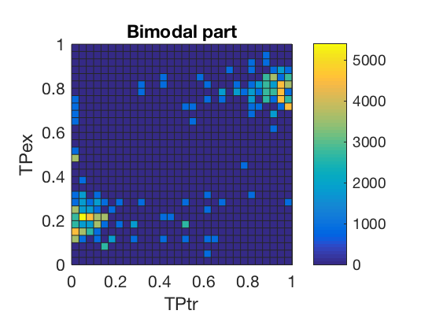
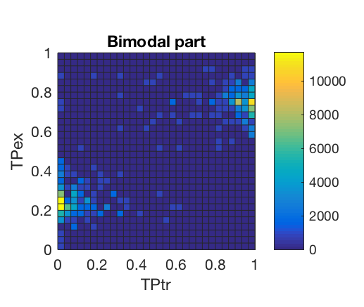
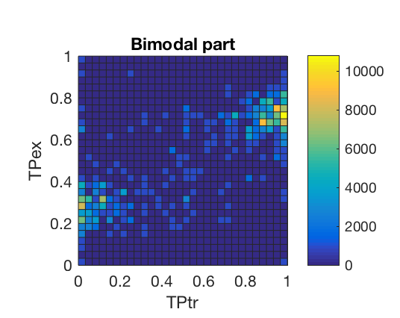
Bivariate analysis showed that the mono-expressed allele
was distinctly linked to the dominant DNA fraction
PRAD
BRCA
LUAD
Chr 1p
Chr 7p
Chr 4
.2/.8
.25/.75
.33/.67
0/1
0/1
0/1
P=8.12E-7
P=7.41E-9
P=4.92E-10

Slide 14
HYPOTHESIS BASED ON BIOLOGICAL ASSUMPTIONS
Samples with concordant VAFs
VAF{tDNA} = VAF {tRNA}
Samples with both concordant and discordant VAFs
VAF{tDNA} = VAF {tRNA}
VAF{tDNA} <> VAF {tRNA}
PURE / SINGLE GENOME SAMPLES:
- VAF{tDNA} = VAF{tRNA} = 0.33/0.67 = ASx2
- VAF{tDNA} = VAF{tRNA} = 0.25/0.75 = ASx3
- VAF{tDNA} = VAF{tRNA} = 0.2/0.8 = ASx4
- VAF{tDNA} = VAF{tRNA} = 0/1 = AS deletion
SAMPLES WITH GENOME ADMIXTURE
CONCORDANT REGIONS reflect AS amplificatiions
DISCORDANT regions reflect deletions
EMD measured distance VAF{tRNA} – VAF {tDNA} reflects the level of admixture

Slide 15
PROPOSED MODEL for INTEGRATIVE ASSESMENT of VAF{tDNA} and VAF{tRNA}
to INFER GENOME PLOIDY and ADMIXTURE
LOW/ABSENT ADMIXTURE
GENOME ADMIXTURE
ALLEIC TRANSCRIPTION

Slide 16
PROPOSED MODEL for INTEGRATIVE ASSESMENT of VAF{tDNA} and VAF{tRNA}
to INFER GENOME PLOIDY and ADMIXTURE
1) Select all the combinations of p_N and ASCNA and ASD that fit all the observed VAFs along the data, by performing the full search on the Model Dictionary.
2) Restrict the solution space:
Within a sample, all genome segments reflect equal mixture composition.
The genome of the normal cells is diploid. Thus, if a normal genome is part of the admixture they will present with two copies of all genome segments.
The number of cellular subpopulations is less than the number of genome intervals.
The copy numbers of the intervals are integers.
Rank possible optimal solutions by complexity; return all the models with assigned complexity.
Further tune using expert knowledge.
MODEL DICTIONARY
Possible idealized VAF distributions
(*5.10e8 for r_N=5 and ASCNA=5)
0.5
unimodal
0.33 0.67
0.25 0.75
bimodal
0.2 0.8
0 1

Slide 17
PROPOSED MODEL for INTEGRATIVE ASSESMENT of VAF{tDNA} and VAF{tRNA}
to INFER GENOME PLOIDY and ADMIXTURE
VALIDATION AND BENCHMARKING
1) EMD-measured VAF{tRNA}-VAF{tDNA} distance positively correlated with known level of admixture
(P < 0.001); Aran et al., Nat Communications, 2015
2) In samples with moderate-to-high admixture (CPE<0.9), the concordant VAF{tRNA}-VAF{tDNA} patterns corresponded to amplifications, and the discordant patterns corresponded to deletions (P < 0.000001). CNA measured by SNPv6, showed high correlation with EMD-estimated RNA-DNA distance (P<0.01).
3) THetA (Oesper et al, 2013) estimated sample composition and CNA strongly correlated with the model (P<0.00001)

Slide 18
Summary
Integration of sequential biological layers, such as genomes and transcriptomes, is feasible, and can mutually empower their analyses far beyond the linear addition of the separate datasets.
EMD offers an alternative, robust and sensitive approach to solve ploidy alterations and genome admixture.
In regards to RNA, EMD provides novel means to assess the information content in biological contexts, where allele dynamics is important, yet challenging to study.

Slide 19
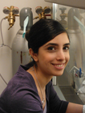









Acknowledgments
Mercedeh Movassagh, M.Sc.
Prakriti Mudvari, PhD
Paula Resrepo, B.Sc
Muzi Li, M.Sc
Krasimira Tsaneva-Atanasova, PhD
Piotr Slowinski, PhD
Nathan Edwards, PhD
Nawaf Alomran, M.Sc.
Notes:
So this was a really huge, still on-going effort, for which I would like to thank to many people

